Slide 1

Funding Opportunities for Chemists at the National Science Foundation Division of Undergraduate Education
Pamela Brown, NSF Program Director
Division of Undergraduate Education (DUE)
195th 2YC3 Western Conference
MiraCosta College, Oceanside, CA
March 30, 2012

Slide 2
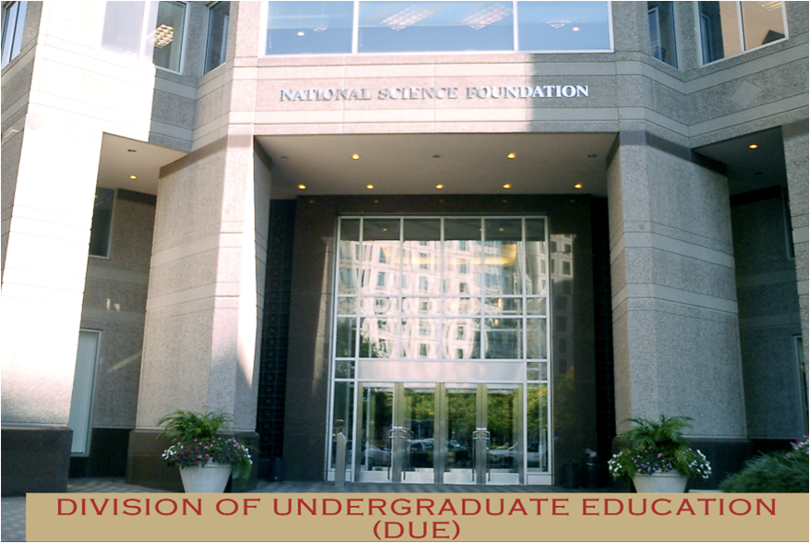
NSF DUE Mission – Promote excellence in undergraduate STEM education for all students
Each solicitation has its own objectives.
All proposals are judged on common intellectual merit and broader impacts.
Some solicitations have additional criteria.
The success of the NSF’s effort depends on the peer review process.
Notes:
2
As reviewers for NSF, you will be evaluating proposals based upon two broad criteria: intellectual merit and breadth of impact. I would like to discuss how to interpret the two criteria in the context of the CCLI program.
Criterion I: Intellectual Merit

Slide 3
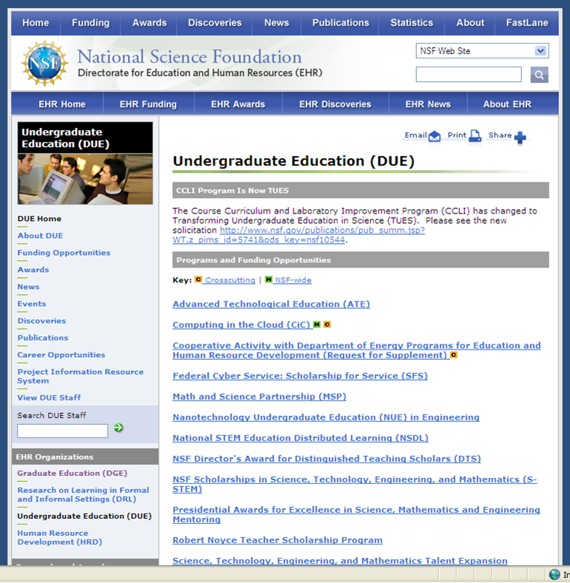
The DUE web page – www.NSF.gov - provides information about solicitation components and awards
Information on current and expired awards is found by clicking on the “Awards” tab at the top of the page and conducting a key word search.

Slide 4
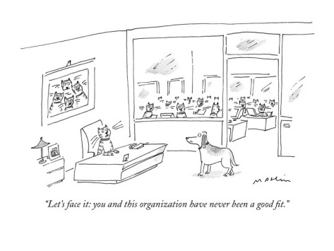
Matching proposal goals and activities with those of the solicitation is important for successful funding
“Let’s face it, you never fit into this organization”

Slide 5
Tonight’s presentation has two components
1. NSF DUE programs of interest:
STEP, ATE, TUES, S-STEM, MSP
2. The review process

Slide 6

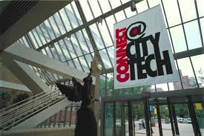

1. STEP: STEM Talent Expansion Program
Basic Goals: Increase the number of graduates (US Citizens or permanent residents) in STEM
+
Type 1 - implementation at academic institutions
Type 2 – educational research projects on associate or baccalaureate degree attainment in STEM
+
=

Slide 7



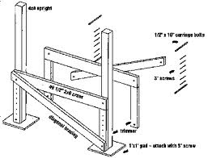
1. STEP awards implement best practices based on an institutional self-study
Bridge programs that enable additional
preparation for students from HS or CC
Programs to improve the quality of student learning
  Peer tutoring, learning communities, etc.
  new pedagogical approaches
Programs to encourage undergraduate research
Recruitment. Student support mechanisms

Slide 8


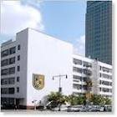
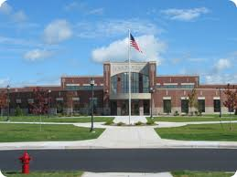
2. ATE: Advanced Technological Education
Focus on two-year programs. Emphasis on the education of technicians for the high-technology fields that drive the nation’s economy.

Slide 9

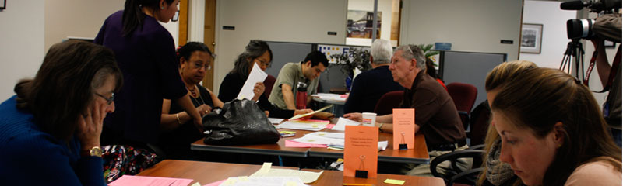

2. ATE supports technician education
Curriculum development based on workforce needs; internships and research opportunities
College faculty and secondary school teacher professional development
Career pathways from secondary schools to two-year colleges and to four-year institutions; articulation agreements
Educational research to advance knowledge related to technician education

Slide 10

2. Small Grants for Institutions New to the ATE Program provide community colleges with a chance to “get their foot in the door.”
  Stimulate implementation, adaptation, and innovation in all areas supported by ATE.
  Broaden the base of participation of community colleges in ATE.
  Strengthen the role of community colleges in meeting the needs of business and industry
  Available only to community college campuses that have not had an ATE award within the last 10 years or never had one.
Limited to $200,000 over 3 years
Funding rate for FY10 was between 70-80% for this area

Slide 11

3. TUES – Transforming Undergraduate Education in STEM
Focus on one or more of the following:
Creating learning materials and strategies
Implementing new instructional strategies
Developing faculty expertise
Assessing and evaluating student achievement
Conducting research on undergraduate STEM education in technical education

Slide 12
3. TUES Important Project Features
Quality, Relevance and Impact
Student Focus
Use of and contribution to knowledge about STEM education
STEM education community building
Sustainability
Expected measurable outcomes
Project evaluations

Slide 13
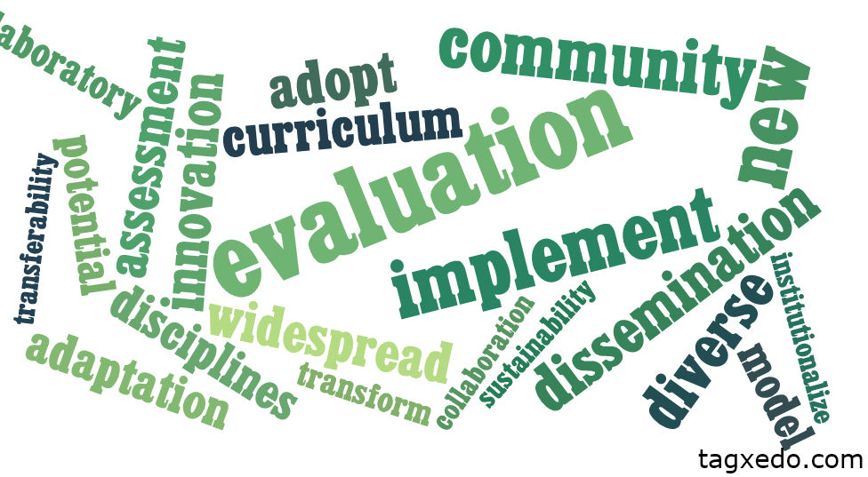
TUES Word Cloud

Slide 14

4. S-STEM: Scholarships in Science, Technology, Engineering, & Math
Goal: Provides funds to institutions to provide scholarships to academically talented, but financially needy, students
Students can be pursuing associate, bachelor’s, or graduate degrees
Scholarships can be up to $10,000/yr - up to 4 yrs within the limits of students official level of need. (They can be less than $10K and less than 4 yrs)

Slide 15
4. S-STEM major features:
Most STEM disciplines are eligible - except Social & Behavioral sciences
One proposal per constituent school or college that awards STEM degrees (e.g., School of Engineering, School of Arts & Sciences, School of Professional Studies)
Institution must provide student support structures and is responsible for selecting scholarship recipients. Optional enhancements: research opportunities, tutoring, internships, etc.

Slide 16

5. MSP: Math Science Partnerships
MSP is an educational research and development effort to improve K-12 student achievement in STEM through partnerships of institutes of higher education and K-12 school districts. Targeted Partnerships: Prototype or Implementation
+
=

Slide 17


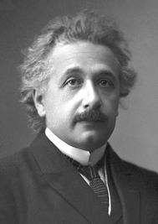

5. MSP Targeted Partnerships have four focal areas
Community enterprise for STEM learning
Current issues related to STEM content
Identifying and cultivating exceptional talent
K-12 STEM teacher preparation

Slide 18
NSF DUE Funding – FY 2011
 | AWARDS | DECLINESDE | TOTAL | % AWARDS
ATE | 71 | 162 | 233 | 30%
MSP - total | 15 | 148 | 163 | 9%
S-STEM | 90 | 270 | 360 | 25%
STEP | 17 | 190 | 207 | 8%
TUES Resource | 10 | 5 | 15 | 67%
Type 1 | 156 | 1003 | 1159 | 13%
Type 2 | 54 | 242 | 296 | 18%
Type 3 | 3 | 59 | 62 | 5%
TOTAL | 416 | 2079 | 2495 | 17%

Slide 19
ATE is NSF DUE’s largest program for community colleges

Slide 20

The review process is based on
Intellectual Merit and Broader Impacts

Slide 21
All proposals are evaluated using the National Science Board approved review criteria
  Intellectual merit (IM)
  Broader impacts (BI)
Some solicitations have additional criteria
Criteria are NOT:
  A complete list of “requirements”
  Applicable to every proposal
  An official checklist

Slide 22
Features of Competitive Proposals
Original ideas. Potentially high impact.
Succinct, focused project plan. Sufficient detail provided.
Realistic amount of work – timeline and responsibility delineated.
Cost effective – budget aligned with activities.
Demonstrated knowledge of field (literature survey) and experience of PIs. Project builds on prior knowledge.
Rationale and evidence of potential effectiveness.
Likelihood the project will be sustained.
Solid evaluation plan including formative and summative assessment.

Slide 23
TUES Reviewer Survey: Top Ten Strengths
Commitment to undergraduate education
Outreach to diverse students
Innovative
Highly qualified PIs in technical areas
Identified significant issues
Detailed development plans
Develop portable products/dissemination
Building onto existing ideas/literature
Implement active learning
Utilize knowledge of how we learn
Writing Style and structure well done

Slide 24
Reviewer Survey: Top Ten Weaknesses
Lack of assessment
Not transformative/low impact
Not meeting grant criteria (did not follow solicitation)
Lacks dissemination plan
Lacks defined outcomes
Does not build on prior work/not analyzing literature
Not sustainable/failure to develop institutional support
No actual commitment to reach minorities
Specific to institution/not transferable
Budget allocation problems

Slide 25
Formative and summative evaluation increase the impact of projects
Each project should have an evaluator who helps design the evaluation. The evaluator needs to be independent of the project. Someone from the project can collect data, but the analysis needs to be done by the independent evaluator.
An inadequate evaluation plan is not necessarily a fatal flaw; if a proposal is otherwise meritorious, the program officer can negotiate an enhanced evaluation plan.

Slide 26
Reviewers rate proposals from Fair to Excellent and prepare comments on strengths and weaknesses/concerns
Excellent (5)/ Very Good (4)/ Good (3)/ Fair (2)/ Poor (1)
Reviewer comments should align with the rating
Ratings may be changed after the panel discussion
Usually a rating of higher than 3.6 makes the proposal competitive
Program directors make funding recommendations. Reviews are used for award negotiations or to provide guidance for declined proposals.

Slide 27
Thank you for your attention
  For more information:
DUE Web Site - http://www.nsf.gov/div/index.jsp?div=DUE
Vet ideas with a program officer
Volunteer to review proposals.
  Opinions expressed in this presentation are those of the presenter and are not official NSF policy
Notes:
27

Slide 28
Summary
NSF DUE programs with research components – STEP, ATE, TUES, MSP. Scholarships through S-STEM
Review of proposals is based on intellectual merit and broader impacts
Understanding the review process will help you prepare better proposals

